Slide 1
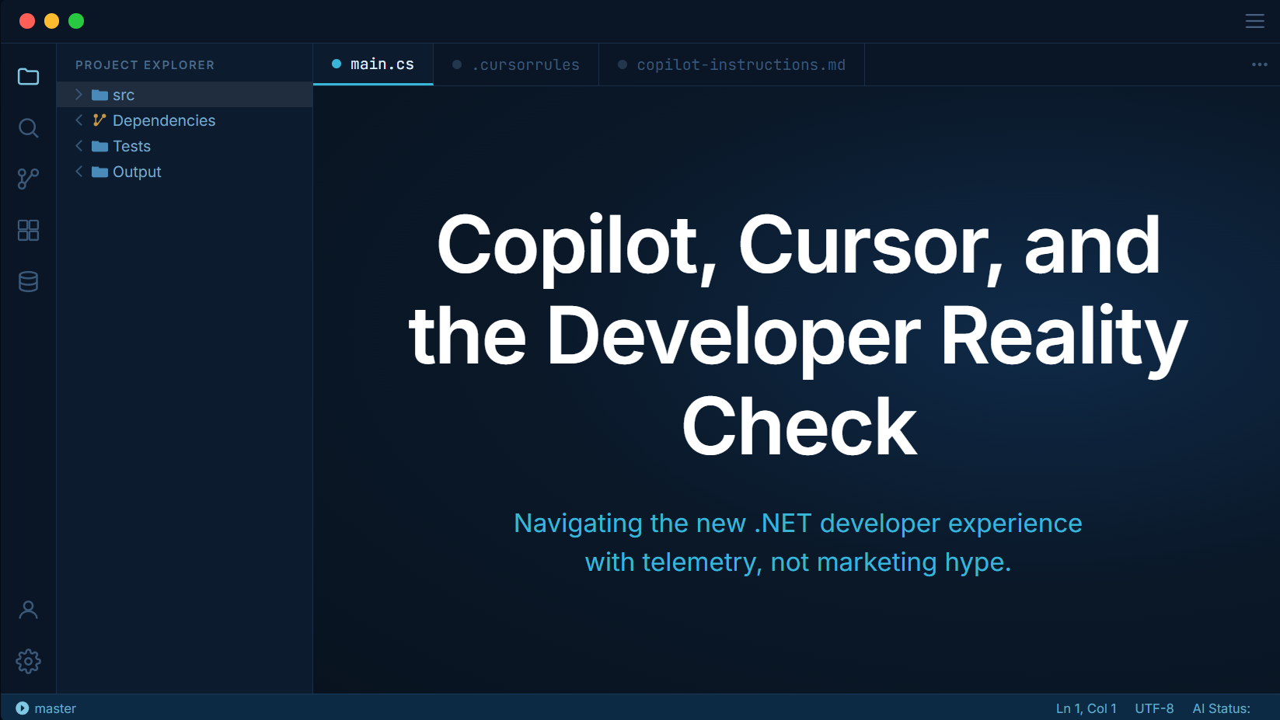

Slide 2











https://www.isaacrlevin.com
@isaacrlevin
https://www.coffeeandopensource.com
@isaacrlevin
@isaacrlevin@fosstodon.org
@isaacrlevin.com

Slide 3

This talk is already outdated…
probably

Slide 4

Things we will not going in depth on
MCP Servers
Claude Skills
MISC Tools

Slide 5
The Productivity Lie
Cutting through the marketing noise to find real value.

Slide 6
Hype vs. Reality
The Promise
The Reality
AI will write 100% of your code, allowing you to focus on "high-level thinking" while it handles the mundane implementation details.
You write 20% more code but spend 40% more time reviewing output that looks correct but fails in edge cases or production load.
Instant feature delivery
Perfect documentation
Zero bug generation
Hallucination oversight
Subscription sprawl
Review Fatigue

Slide 7
LLMs are not tools
A quick refresher on what is what

Slide 8
Defining LLMs
Core Intelligence
Call-based Logic
LLMs are probabilistic, non-deterministic engines designed to generate text based on input prompts. They excel at pattern recognition and linguistic fluency.
Each response is isolated. The model generates output based strictly on the current prompt and provided context, lacking innate persistent awareness.

Slide 9


Limitations of Raw Models
No Memory
Context Limits
No Built-in Tools
Conversation history must be reassembled and fed back for every new call to maintain continuity.
Performance degrades significantly as you approach the hard context window limits of the model.
The core model cannot inherently interact with APIs, databases, or local files without external guidance.

Slide 10
What is a Harness?
A harness is the software layer that wraps around an LLM to control its behavior, inputs, and operational environment.
It acts as the "operating system" for AI agents, ensuring the model stays on track and operates within defined boundaries.

Slide 11



Key Roles of the Harness
Input Shaping
Context Management
Safety & Control
Defining behavior, personas, and constraints via system prompts.
Summarizing and chunking tasks to keep calls within the optimal performance range.
Preventing infinite loops, uncontrolled tool use, and generating unsafe outputs.

Slide 12
Raw LLM vs Harness
Feature | Raw LLM Model | Harness-Enabled System
Memory | Transient / Call-based | Persistent / Stateful
Tool Use | None (Inherent) | API, Code, & System Integration
Autonomy | Single Request | Multi-step / Recursive Loops
Performance | Variable with Context | Optimized through Chunking

Slide 13
What Harnesses do we use?

Slide 14
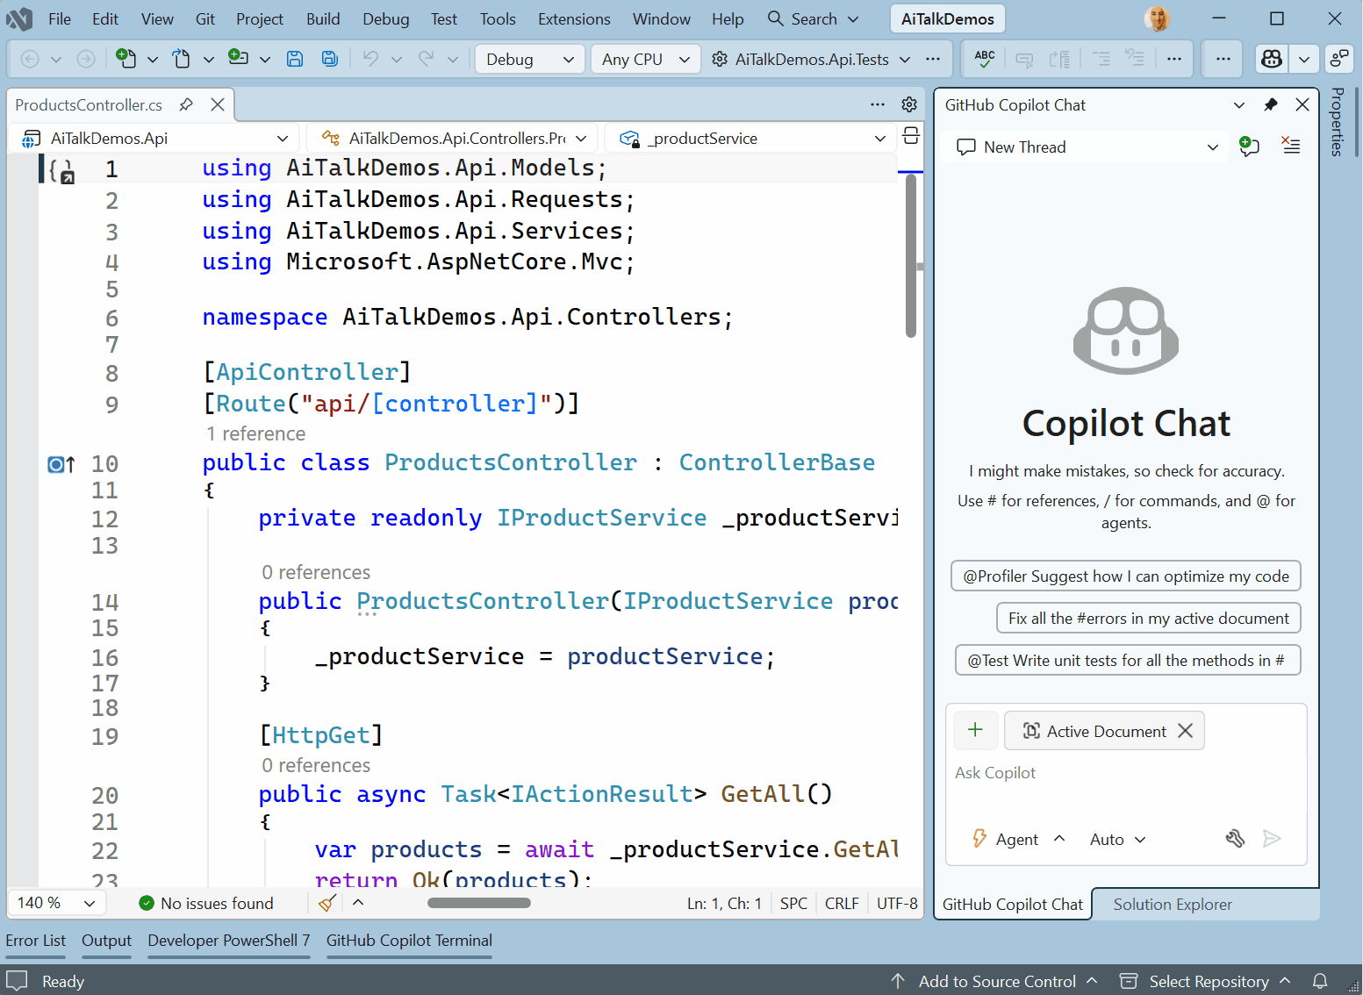
Copilot in Visual Studio
Native Muscle Memory
GitHub Copilot in Visual Studio provides the best experience for legacy .NET Framework and large WPF/WinForms solutions.
Full integration with Ctrl + . Actions and Intellisense
Agent Mode for autonomous multi-file edits
Tight coupling with MS Build and debugger
IP Indemnity for enterprise compliance

Slide 15
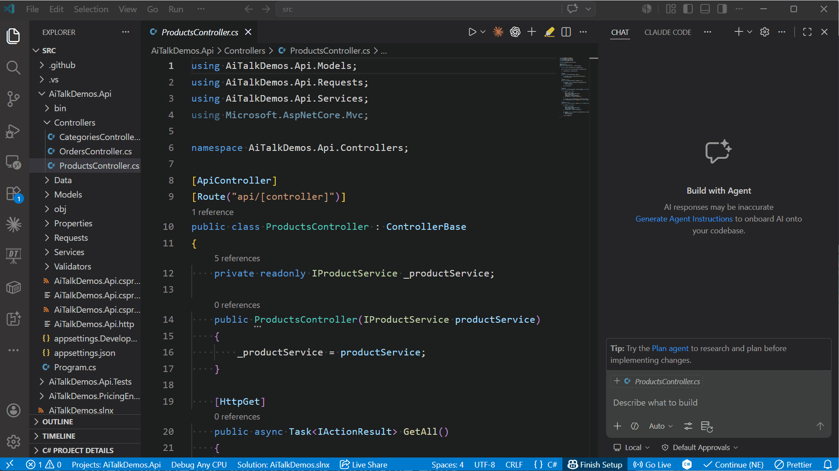
Copilot in Visual Studio Code
Next-Gen Productivity
GitHub Copilot in Visual Studio Code provides the leading experience for modern web, cloud-native, and open-source development.
Edit Mode for multi-file code transformations
Chat & Inline Chat for real-time natural language help
Extensions Ecosystem for specialized AI skills
Terminal Integration for CLI command assistance

Slide 16
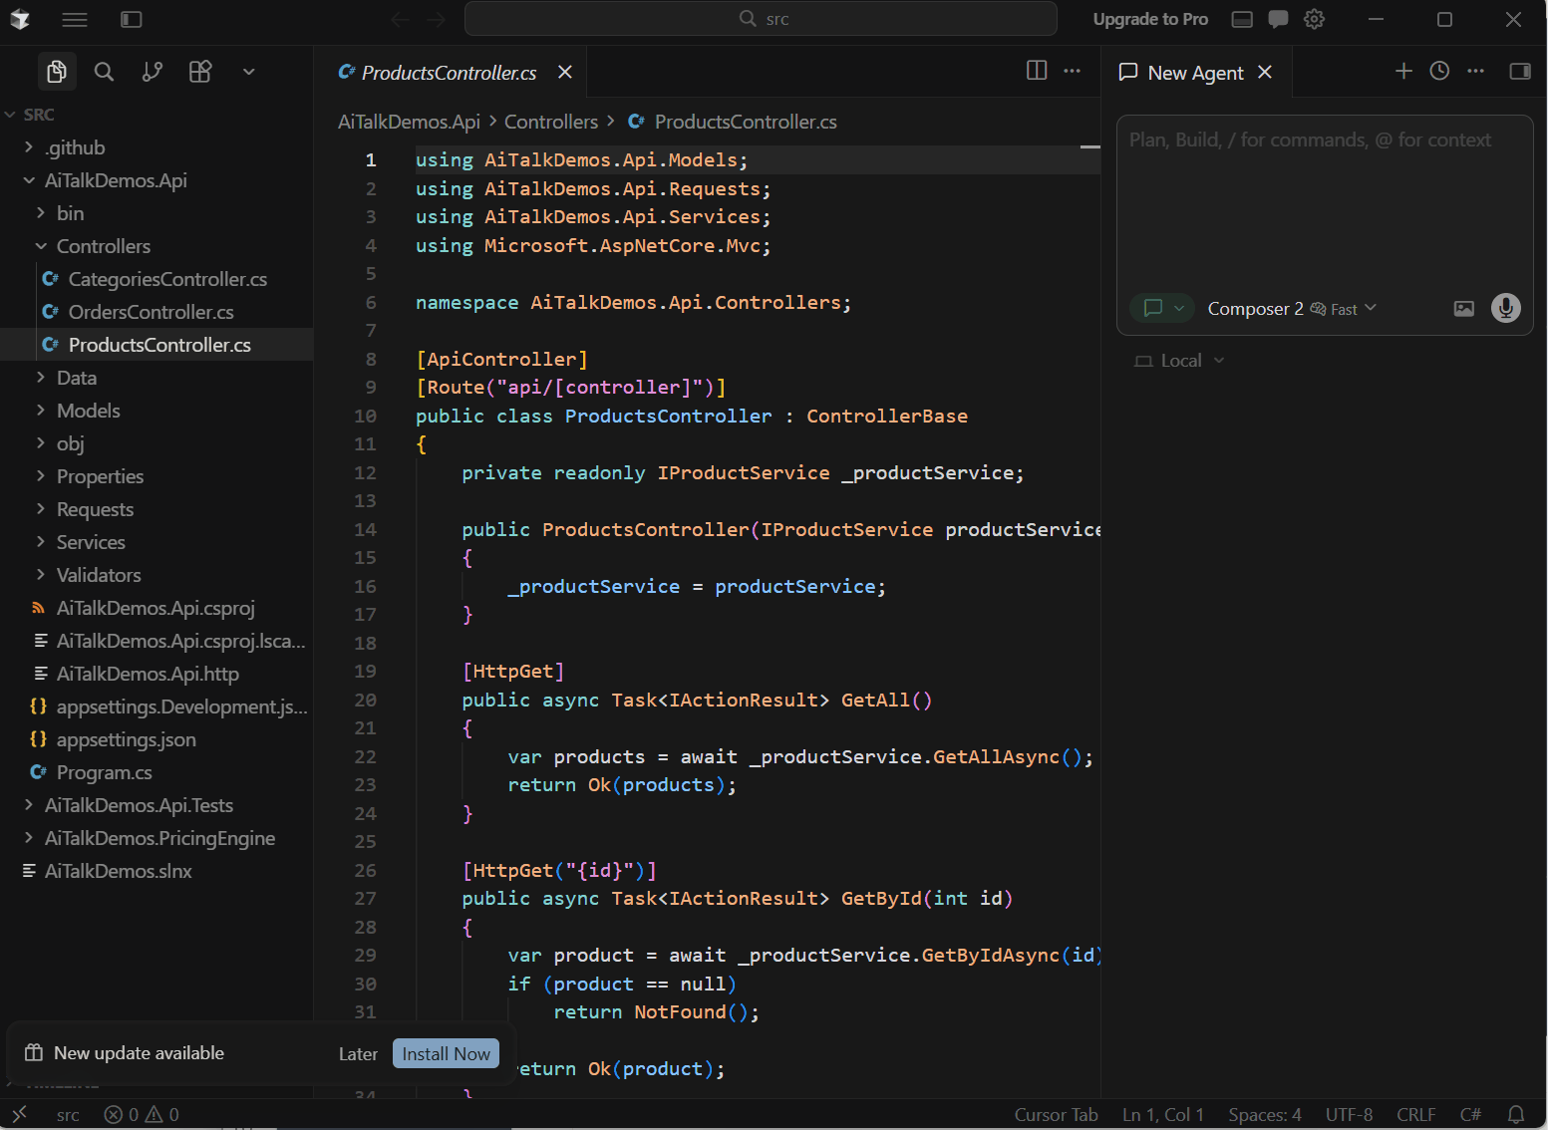
Cursor AI
The Context Advantage
Cursor indexes your entire solution from day one, allowing the AI to "know" your internal packages and domain models without prompting.
Automatic project-wide RAG indexing
"Composer" proprietary agentic model
Custom Scoped Rules (.cursor/rules)
Proprietary codebase awareness

Slide 17





Where are the other tools?

Slide 18
Context is Everything
Why LLMs hallucinate on your code and how to stop it.

Slide 19

The Root Cause: The Context Gap
ASP.NET Core
boilerplates
LLMs are pattern-matching engines, not reasoning engines. They know public frameworks perfectly, but they have never seen your company’s internal domain models
Hallucinations occur because the model attempts to fill your proprietary domain gaps with generic public patterns
Standard EF
Core Queries
Public Code
Training Data
Version
Conflicts
Your Enterprise
Reality
Legacy
business logic
Proprietary
NuGet Packages
Custom IUnitOfWork
patterns
Ambiguity in requirements is the new bottleneck, not typing speed.
If you can’t clearly explain your business rules to the IDE,
the AI cannot code them.

Slide 20

The Context Funnel
Passive Context
XML doc comments, clear naming (CustomerRepository vs Repo), and top-level ARCHITECTURE.md
Generic LLM
(Sonnet / GPT)
Workspace Context
(@workspace)
Explicit Rules
Instructing the LLM directly with local files:
“Always use record types for DTOs”
Local Rules
(.cursor/rules
copilot-instructions.md)
Enterprise RAG
(Semantic Kernel)
Enterprise RAG
Indexing 1000s source code lines into vector databases to inject relevant proprietary snippets at query time
High Fidelity Code

Slide 21
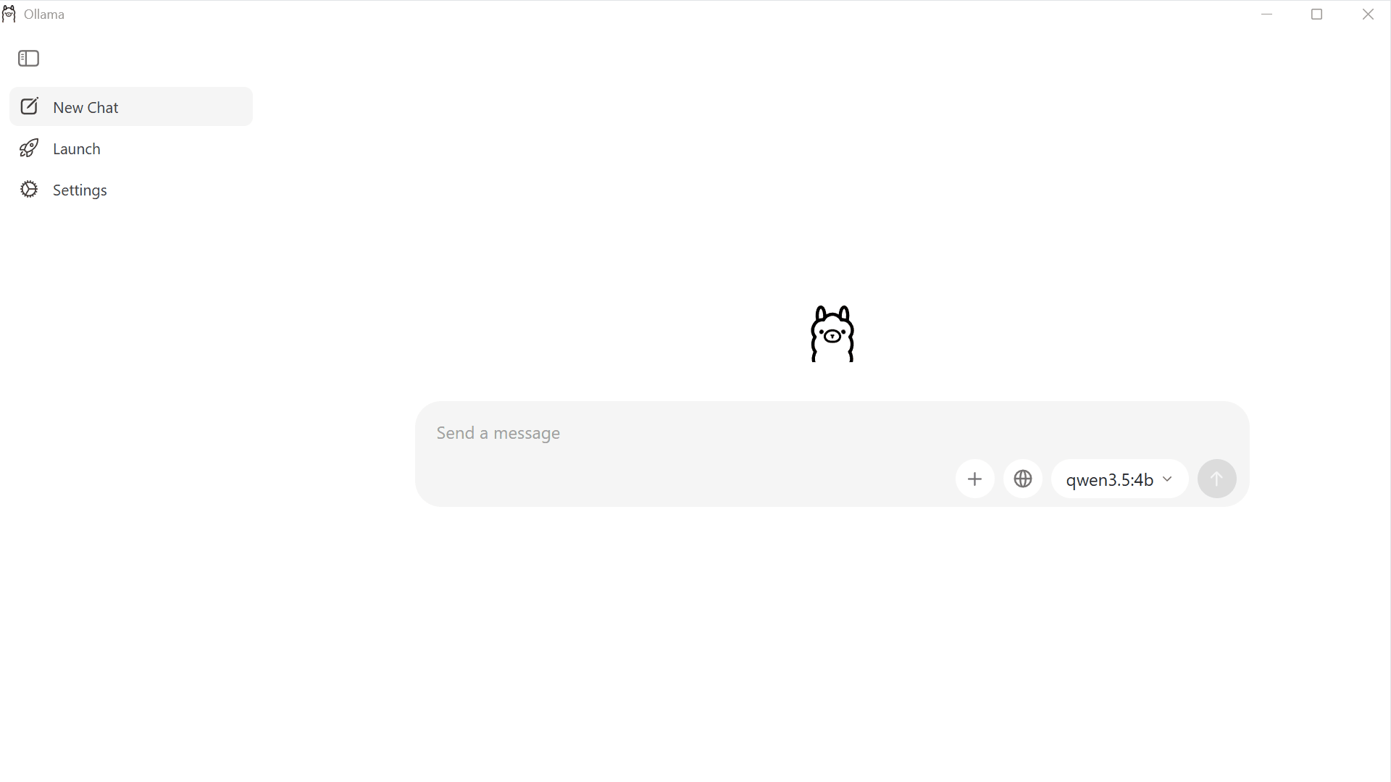
Local LLMs: Ollama
Regulated Environments
For healthcare, finance, or highly proprietary .NET logic where cloud APIs are legally prohibited.
Model Selection
Use models like qwen*-coder or deepseek-coder type models for strong C# reasoning without leaving your machine.
Trade-off
5-10x slower latency vs cloud
Probably need a powerful device

Slide 22
Let’s See Some Demos

Slide 23
The New Reality

Slide 24
The Attention Shift
We are transitioning from writers to auditors

Slide 25
The New Developer Loop
The Old Loop
Think
Type Code
Test
Review
AI Generates
Human Audits
Test
Define Context/Prompt
System Integration
The New Loop

Slide 26
The Agentic Tech Debt Loop
Findings from a Difference-in-Differences study of 807
Cursor adopted repositories vs 1,380 control repos
AI Adoption
Transient Velocity Gain: 1-2 months
Increased Codebase Size & Bloat leads to 9.0% Increase in code complexity & static analysis warnings
Future Velocity dampened to baseline
Velocity Gains are
highly concentrated in
the first 1-2 months
AI amplifies velocity-quality dynamics:
faster code production leads to a persistent
accumulation of static analysis warnings
Without scaling Quality Assurance, the initial
productivity surge accelerates the journey
toward an unmaintainable codebase

Slide 27
Senior Dev Impact
30%
Focus on Systems
AI automates the boilerplate (DTOs, Mapping, Unit Test Scaffolding). This frees senior talent to focus on what matters: System Architecture, Domain Modeling, and Security Audits.
Productivity Gain
Shift from 'Writer' to 'Auditor'.

Slide 28
Every time you press enter
it costs someone money

Slide 29
The Verdict
“These tools are not magic. They will not replace senior judgement, and they will not fix broken architectures. But they will fundamentally change where you spend time.”
Pick the right tool for
the codebase context
Invest heavily in
Context Engineering
Scale QA to match
generation velocity

Slide 30
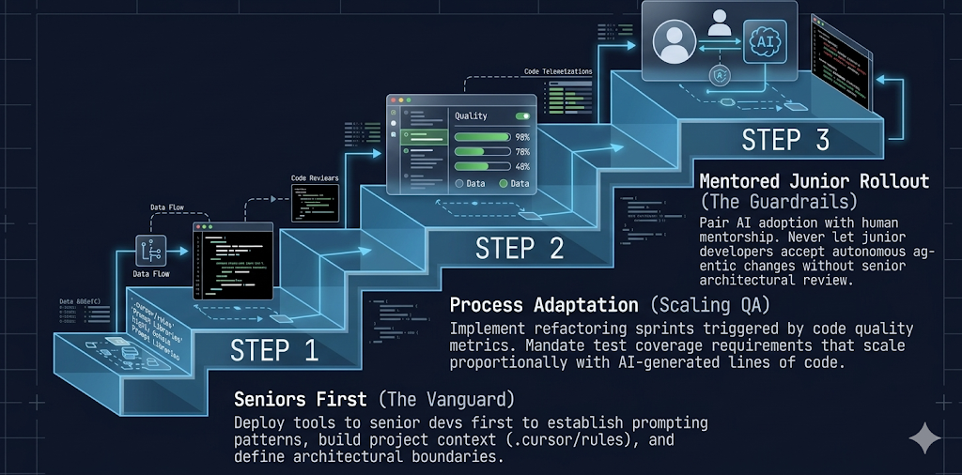
The “Right Way” Adoption
Mentored Junior Rollout
Pair AI adoption with human mentorship. Never let junior developers accept autonomous agentic changes without senior architectural review
Process Adaption
Implement refactoring sprints triggered by code quality
metrics. Mandate test coverage requirements that scale
proportionally with AI-generated lines of code.
Seniors First
Deploy tools to senior devs first to establish prompting
patterns, build project context
and define architectural boundaries.

Slide 31


Questions?
Thank you for attending!
@isaacrlevin

